Slide 1

Plagiarism detection
yashasvini
21311A05D2
CSE C
incharge : Sreenivasa sir
-

Slide 2
contents
Plagiarism
Effects of plagiarism
Avoiding plagiarism
Plagiarism detection
Approaches
Performance
Software
Algorithm
Program
Disadvantages
conclusion
References

Slide 3
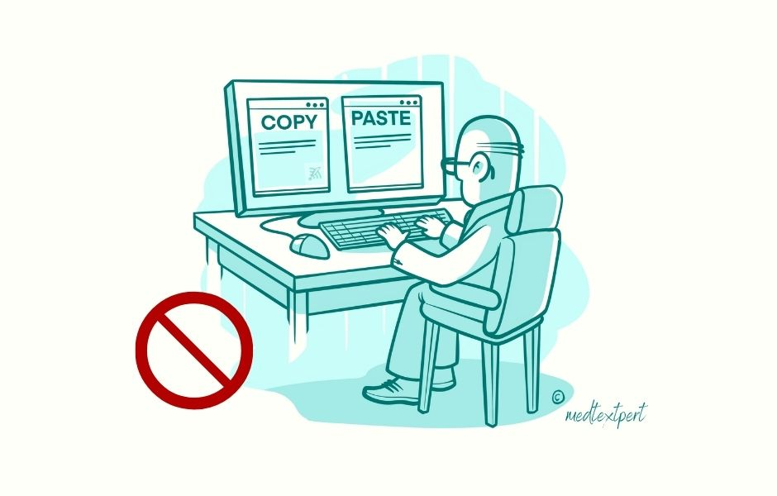
Plagiarism
Plagiarism involves activities that present another author’s ideas, thoughts or research as your own without acknowledging its source.
For a long time, plagiarism has been a prevalent issue in academic institutions.
There is no upside to plagiarism, it only shows the student lacks integrity and critical thinking.

Slide 4
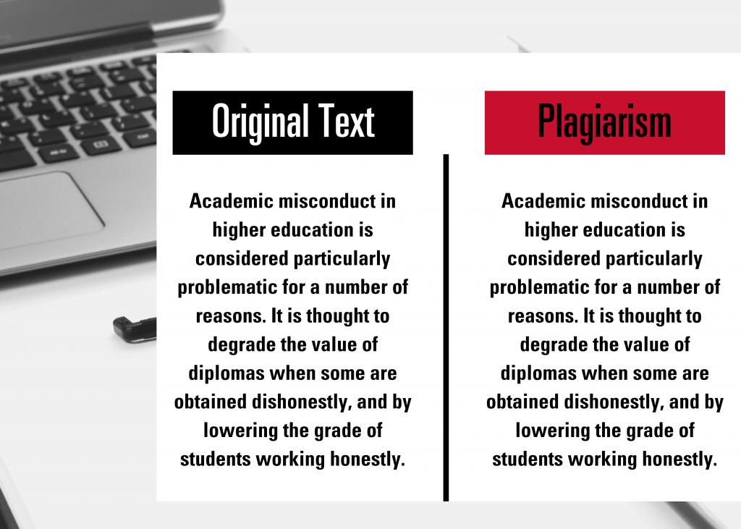

Slide 5

Effects of plagiarism
The consequences of plagiarism rub off on the culprit, other students, the academic institution, and the economy as a whole.
When a student plagiarizes their coursework, the efforts other students put into theirs become discredited and the authenticity of the standard of learning at the institution is devalued.
Plagiarism can be deliberate or unintentional.
Some students are guilty of plagiarism because they didn’t give proper credit to the source of the information used in their project.
Some students however deliberately attempt to pass another author’s work or idea as theirs for a variety of reasons

Slide 6
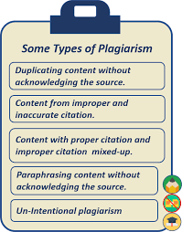


Slide 7
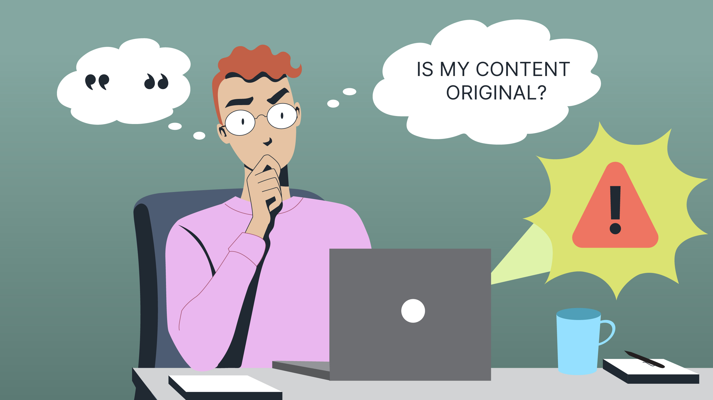
Avoiding plagiarism
1. Start working on your coursework early.
2. Do proper research.
3. Present original ideas.
4. Acknowledge your sources.
5. Proofread your article and use a plagiarism checker.

Slide 8
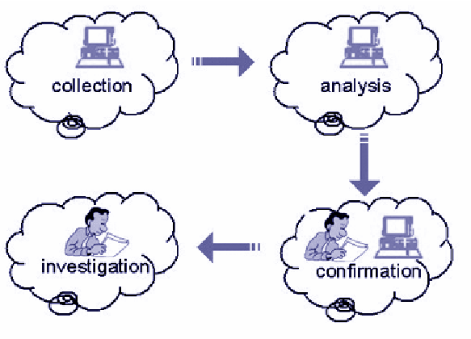
Plagiarism detection
Plagiarism detection or content similarity detection is the process of locating instances of plagiarism or copyright infringement within a work or document.
Human detection is the most traditional form of identifying plagiarism of written work.
Computer-assisted plagiarism detection (CaPD) is an Information retrieval (IR) task supported by specialized IR systems, which is referred to as a plagiarism detection system (PDS) or document similarity detection system

Slide 9
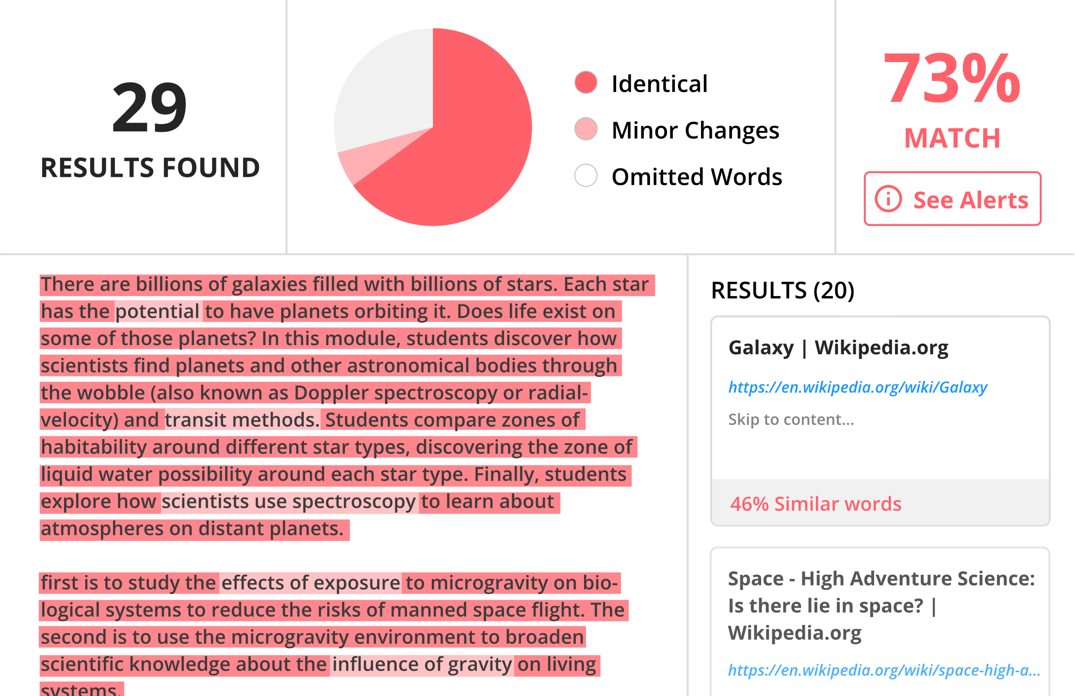

Slide 10
Plagiarism checking apps
Grammarly-allows a user to scan a text through billions of web pages on the internet to search for duplicate content and guide through proper citation.
Duplichecker -app is that it is free and it allows different file types to be scanned through the internet’s wide database
Paper rater - PaperRater uses AI technology to check for plagiarism, and spot similar content as well as grammar and vocabulary errors.
Turnitin-features are targeted at helping teachers conduct a thorough scan of students’ coursework.
Plagscan -allows users to compare the originality of a text against other documents on the web.

Slide 11
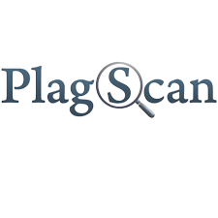





Slide 12
Approaches
The approaches are characterized by the type of similarity assessment they undertake: global or local.
Global similarity assessment approaches use the characteristics taken from larger parts of the text or the document as a whole to compute similarity,
while local methods only examine pre-selected text segments as input

Slide 13
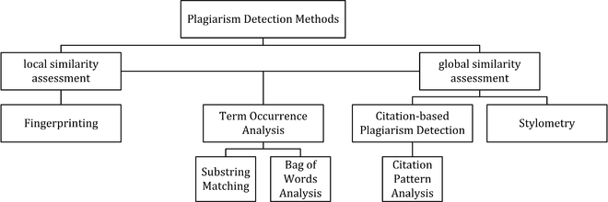

Slide 14
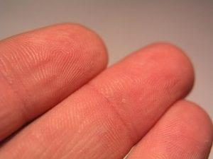
Fingerprinting
Using a complex mathematical process, you take a lengthy work, such as a file, a lot of text or something else, and convert it into a unique string, known as a fingerprint.
It takes far less resources to compare two fingerprints than two original works.

Slide 15
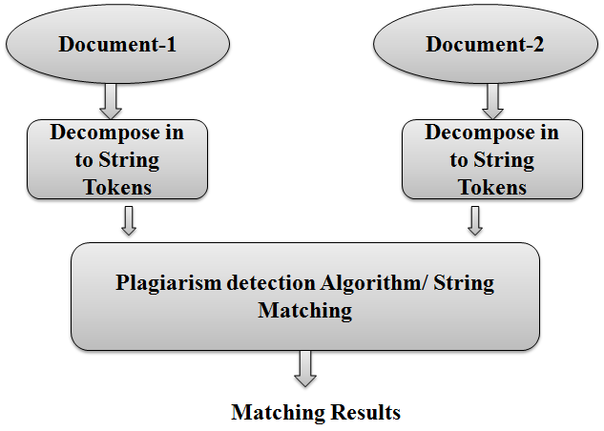
String matching
The idea is straightforward, you take a string of text from one document, ranging from a few words to a dozen or more, and then try to find that same string in other documents. Then, repeat the process with another document or another string.
String matching, since it requires comparing two full documents, requires a great deal more resources and is cost/time prohibitive by itself.
It will use fingerprinting when looking at the millions of documents in the database, but turn to string matching when looking at the dozen or so potential matches to find out precisely what content is overlapping.

Slide 16
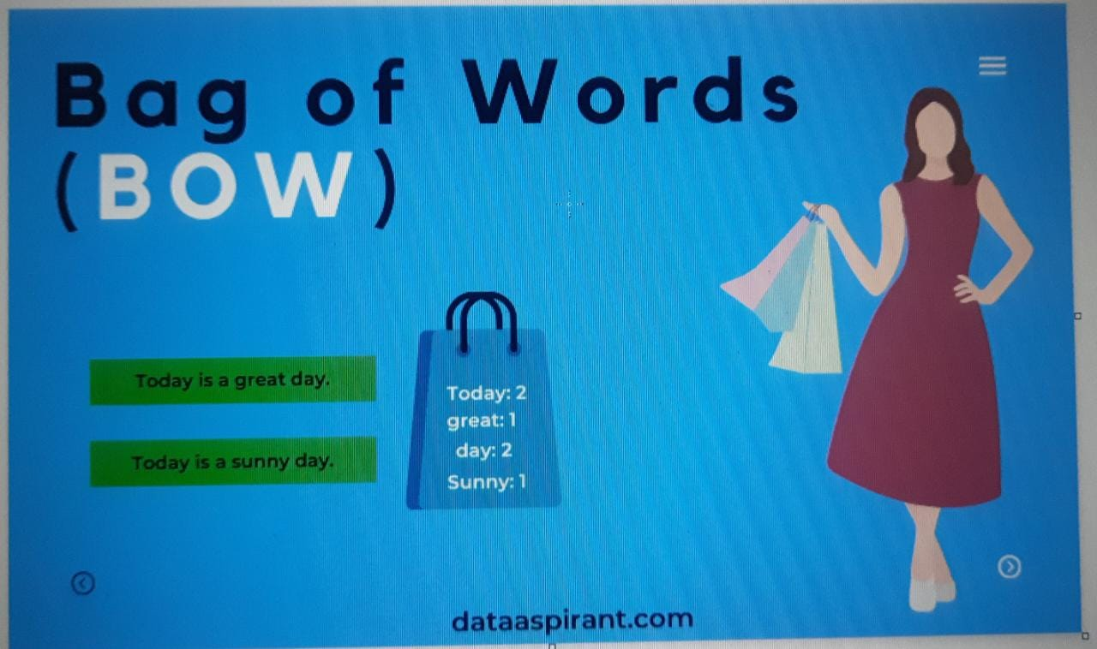
Vector space model
It is bag of words approach.
Even if a plagiarist heavily rewrites or modifies a work, they will still use many of the same words and types of words.
This model looks at the words in a paper but not the order that they are in.
Then, looking at the words themselves, the parts of speech and even some common phrases, can determine the probability that two papers have strong similarity.

Slide 17
Stylometry
Stylometry subsumes statistical methods for quantifying an author’s unique writing style and is mainly used for authorship attribution or intrinsic plagiarism detection.
Detecting plagiarism by authorship attribution requires checking whether the writing style of the suspicious document, which is written supposedly by a certain author, matches with that of a corpus of documents written by the same author.

Slide 18
Citation analysis
Citation-based plagiarism detection examines the citation and reference information in texts to identify similar patterns in the citation sequences.
As such, this approach is suitable for scientific texts, or other academic documents that contain citations.

Slide 19
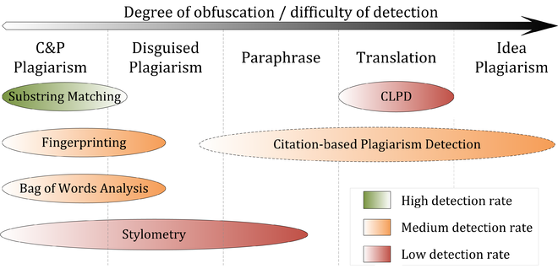
Performance

Slide 20
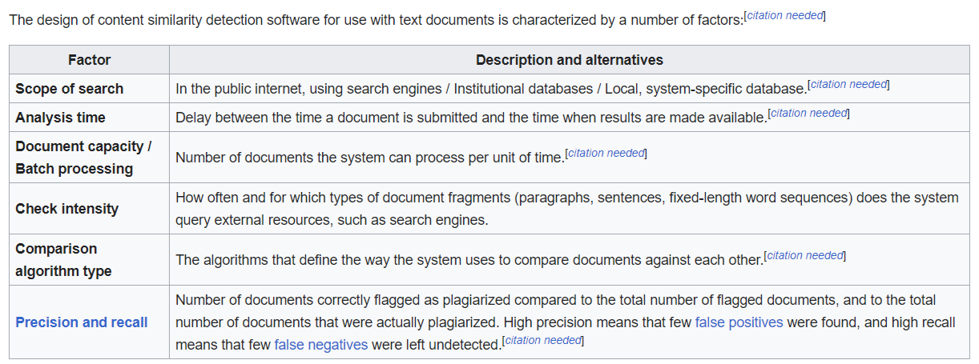
Software

Slide 21
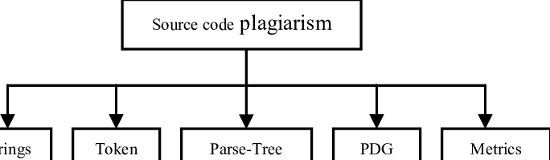
Source code plagiarism
Plagiarism in computer source code is also frequent, and requires different tools than those used for text comparisons in document.
Since most programming assignments expect students to write programs with very specific requirements, it is very difficult to find existing programs that already meet them.
Since integrating external code is often harder than writing it from scratch, most plagiarizing students choose to do so from their peers

Slide 22
source-code similarity detection algorithms can be classified as based on either
Strings – look for exact textual matches of segments fast, but can be confused by renaming identifiers.
Tokens – as with strings, but using a lexer to convert the program into tokens first. This discards whitespace, comments, and identifier names.
Parse Trees – build and compare parse trees.For instance, tree comparison can normalize conditional statements, and detect equivalent constructs as similar to each other.
Program Dependency Graphs (PDGs) – a PDG captures the actual flow of control in a program, and allows much higher-level equivalences to be located, at a greater expense in complexity and calculation time.
Metrics – metrics capture 'scores' of code segments according to certain criteria; for instance, "the number of loops and conditionals", or "the number of different variables used". Metrics are simple to calculate and can be compared quickly, but can also lead to false positives: two fragments with the same scores on a set of metrics may do entirely different things.
Hybrid approaches – for instance, parse trees + suffix trees can combine the detection capability of parse trees with the speed afforded by suffix trees, a type of string-matching data structure.

Slide 23
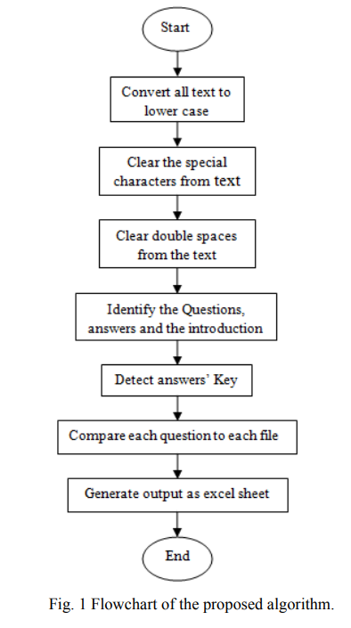
Algorithm

Slide 24
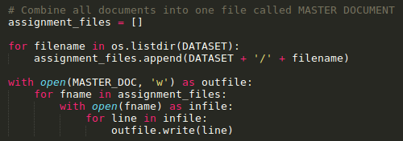
Combining students answer into one single answer file (MASTER DOCUMENT)

Slide 25
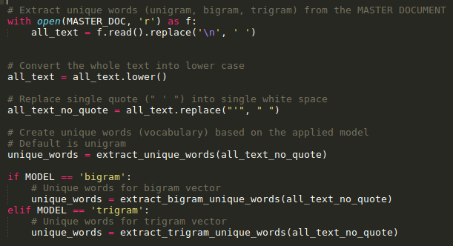
Extract unique words (unigram, bigram, trigram) from the MASTER DOCUMENT

Slide 26
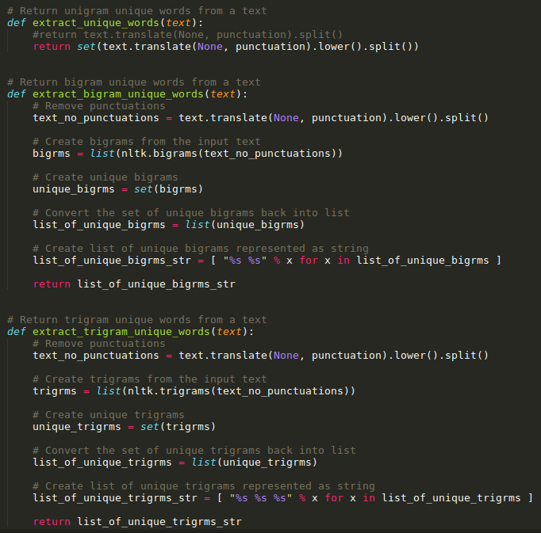

Slide 27
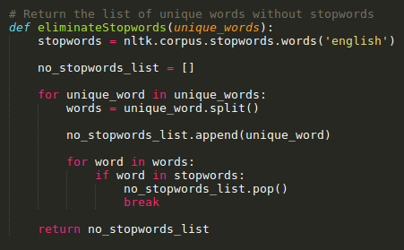
Eliminate stopwords

Slide 28
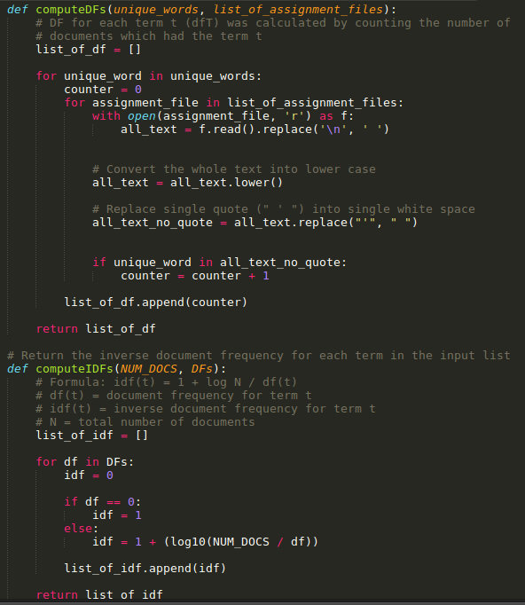
Compute Document Frequency (DF) and Inverse Document Frequency (IDF) for each term

Slide 29
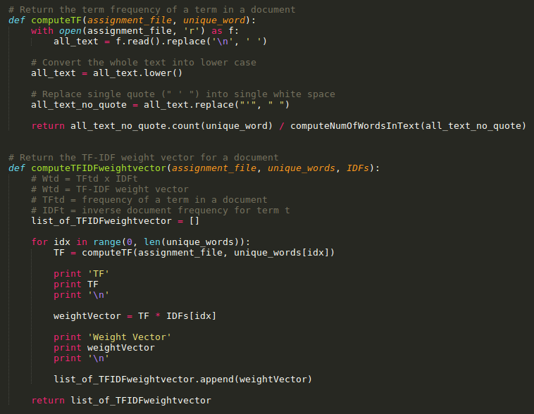
Compute TF-IDF Weight Vector for each document

Slide 30
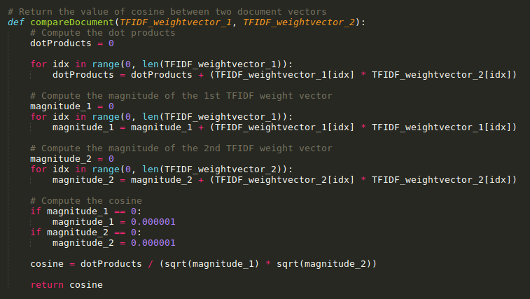
Compare each pair of assignment using Cosine Similarity

Slide 31
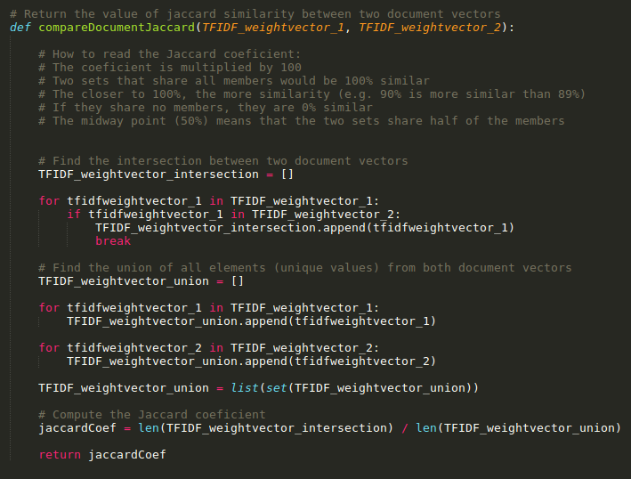
Compare each pair of assignment using jaccard Similarity

Slide 32
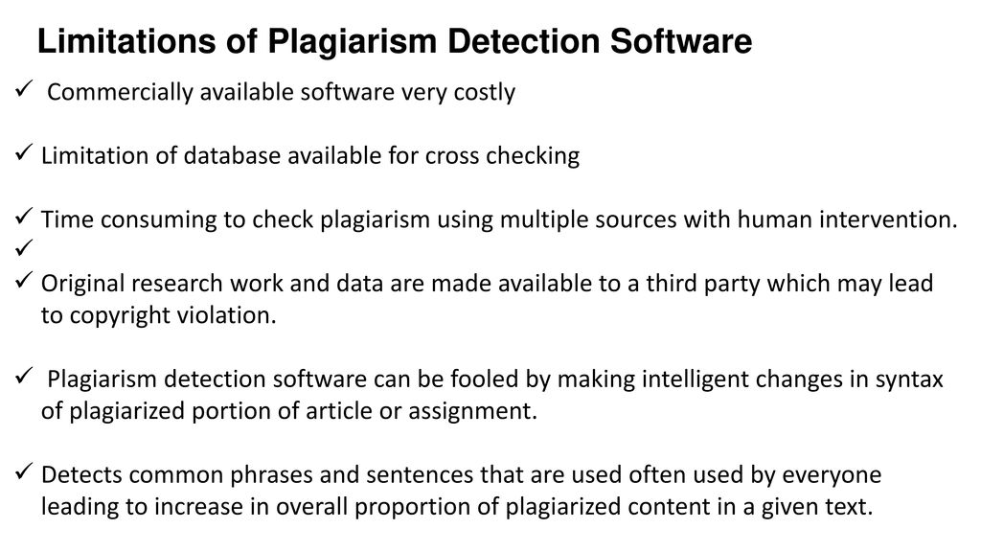

Slide 33
Conclusion
In the age of information technologies plagiarism has become more actual and turned into a serious problem.
Plagiarism prevention methods which are based on societies change of attitude against plagiarism.
Plagiarism detection tools are used for this purpose.

Slide 34
References
Open Learning, the Issue of Plagiarism - Efficient Algorithm(from international journal of computers)
https://en.wikipedia.org/wiki/Content_similarity_detection
https://www.plagiarismtoday.com/2016/05/03/plagiarism-detection-works/
https://degreesandcareers.info/resources/top-plagiarism-checker-apps/

Slide 35
